Slide 1

Web technologies using java
Course 1 - introduction

Slide 2
agenda
The HTTP protocol
HTTPS
web application structure
Web containers
Application servers
servlets

Slide 3
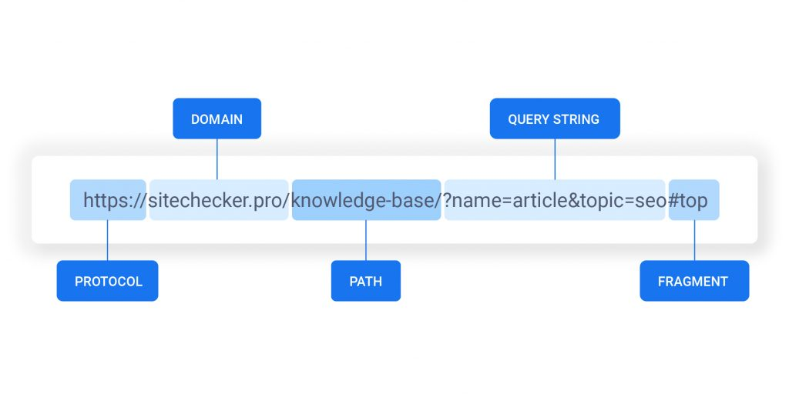
The HTTP protocol
application layer protocol
URI
URL
HTTP methods
HTTP status codes
request
response
Note: Birth of the Web

Slide 4
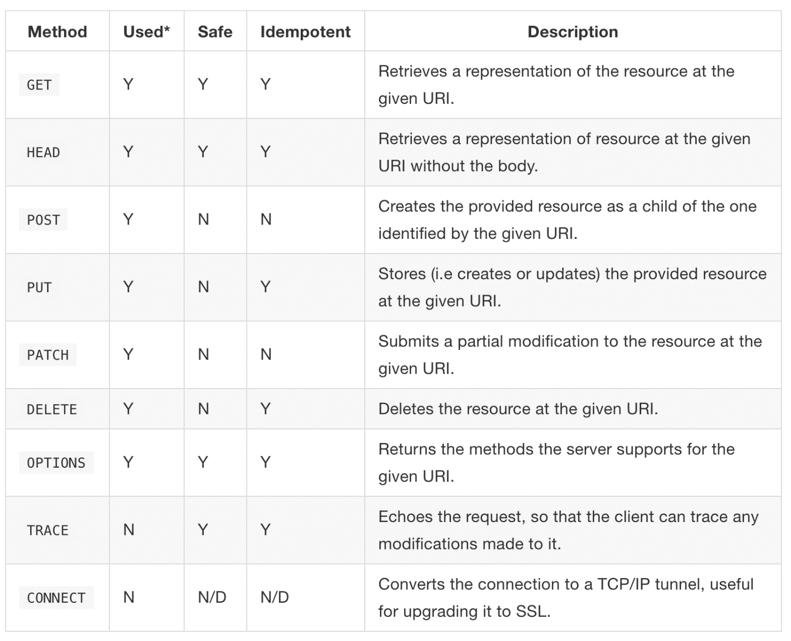
HTTp request methods

Slide 5
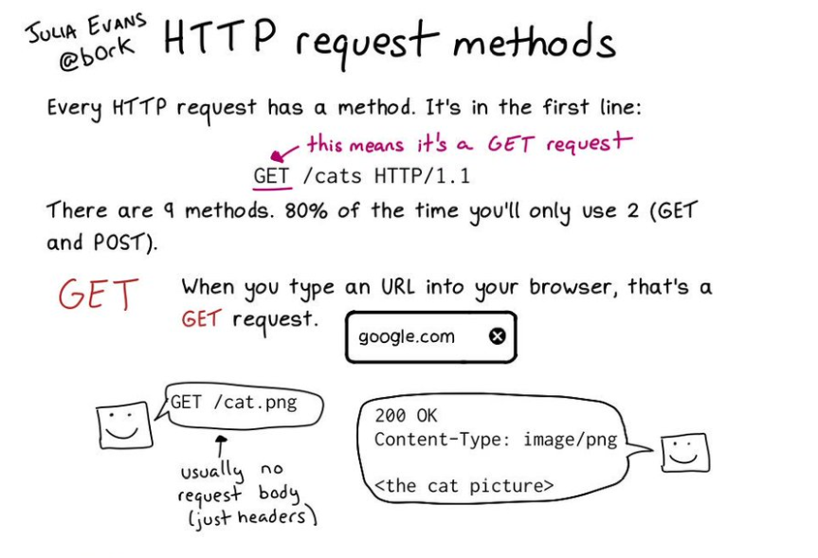
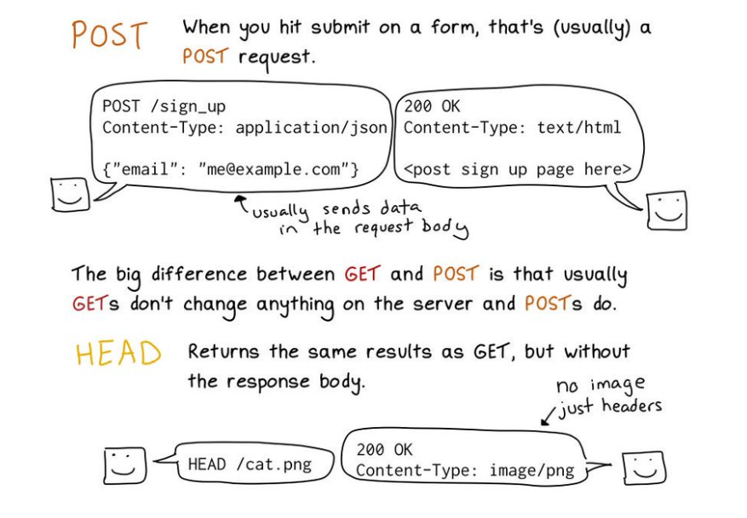
HTTP request methods

Slide 6
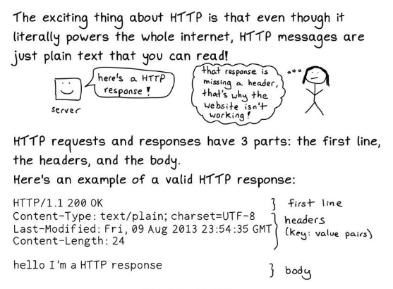
HTTP messages

Slide 7
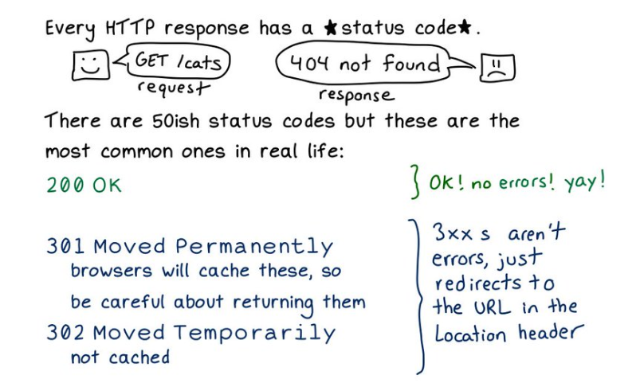
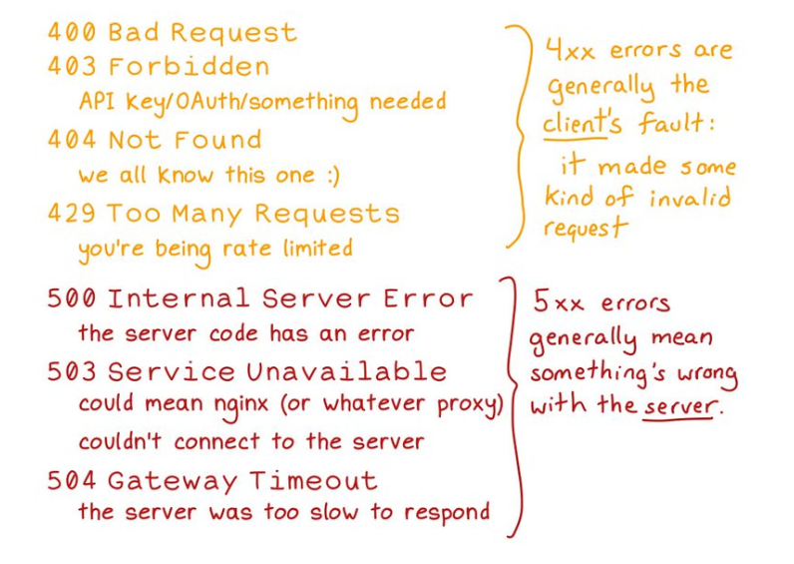
HTTP status codes

Slide 8
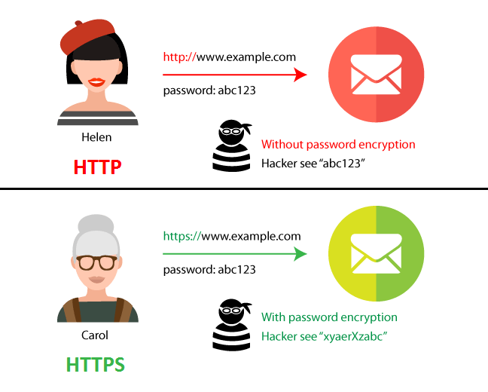
HTTPS
HTTP sent over a secure transport layer (SSL)
all HTTP request and response data is encrypted before being sent across the network
Server certificates

Slide 9
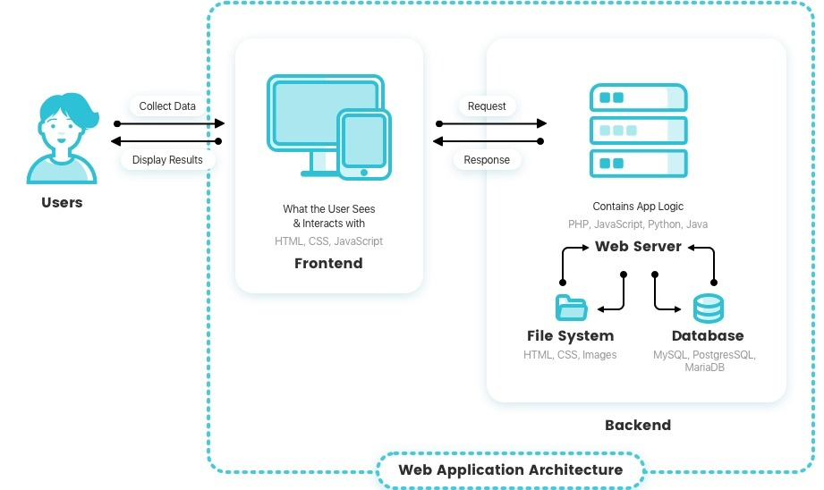
BASIC web application structure

Slide 10
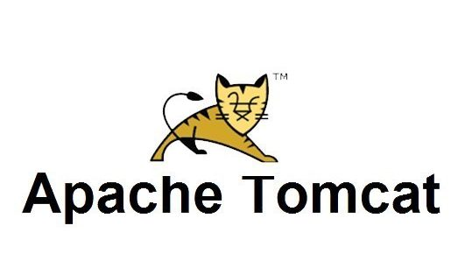
WEB containers
implement only a part of the Java EE specifications
accept and respond to HTTP requests
manage the life cycle of Servlets
map request URLs to Servlet code
are included in application servers

Slide 11



Application servers
implementation of all features in the Java EE specification
include a web container

Slide 12
servlets
receive and respond to requests from the end user
run within a web container
the web container deploys the Servlet with the application
HTTP is the only supported Servlet protocol
Servlet official API documentation

Slide 13
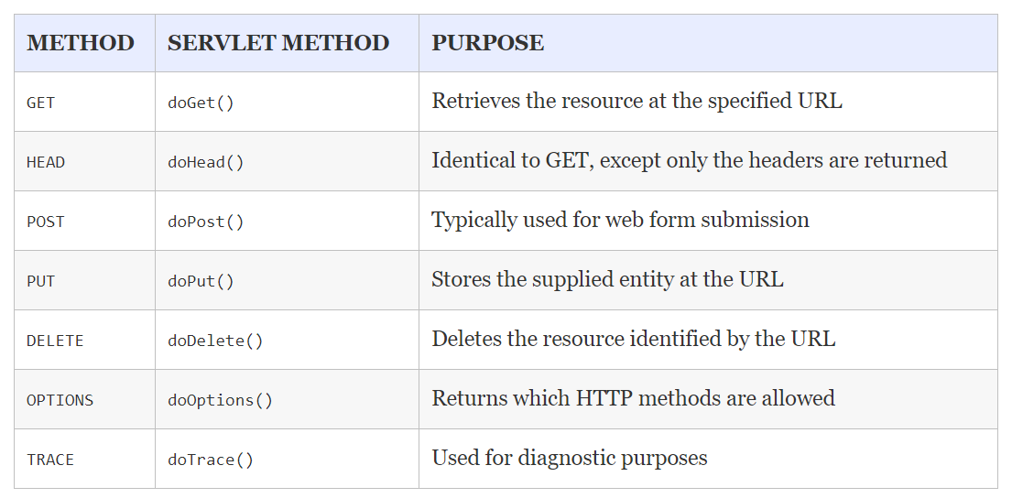
servlets

Slide 14
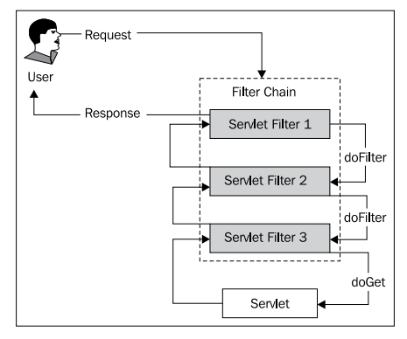
servlets
Servlet filters
can intercept requests and responses, and act on them in some manner
can be mapped to URL patterns
can be used for:
authentication
logging
auditing
error handling
image conversion

Slide 15
bibliography
Professional Java for Web Applications, chapters 1 - 7
HTTP: The Definitive Guide

Slide 16
evaluation
Final grade = max 10 points
exam: 5 points from the final grade
lab: 4 points from the final grade
project: 3 points
small assignments: 1 point
lab attendance: 1 point from the final grade

Slide 17

Q&A

Slide 18
THANK YOU
DANIELA CIUPERCA

